Slide 1
Small Groups
Great Blessings
Interamerican Division
SMALL GROUPS IN THE OLD TESTAMENT
CHAPTER
1

Slide 2
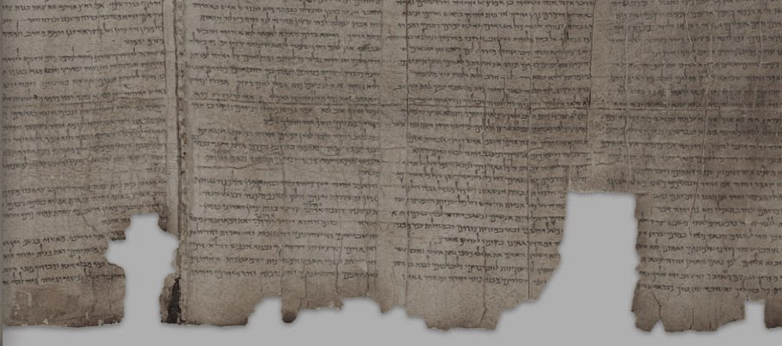
Chapter 1
Small Groups in the old testament

Slide 3
God established a relational paradigm for the created order.
From the perspective of the Old Testament, we note that relational, sapiential and missional dimensions characterize the human groups called by God throughout the history of salvation.

Slide 4
A Relational Theology
In the overview of the creation story (Gen. 1:1-2:3), the Creator is seen to assume a deeply relational stance in the production and formation of the created world.

Slide 5
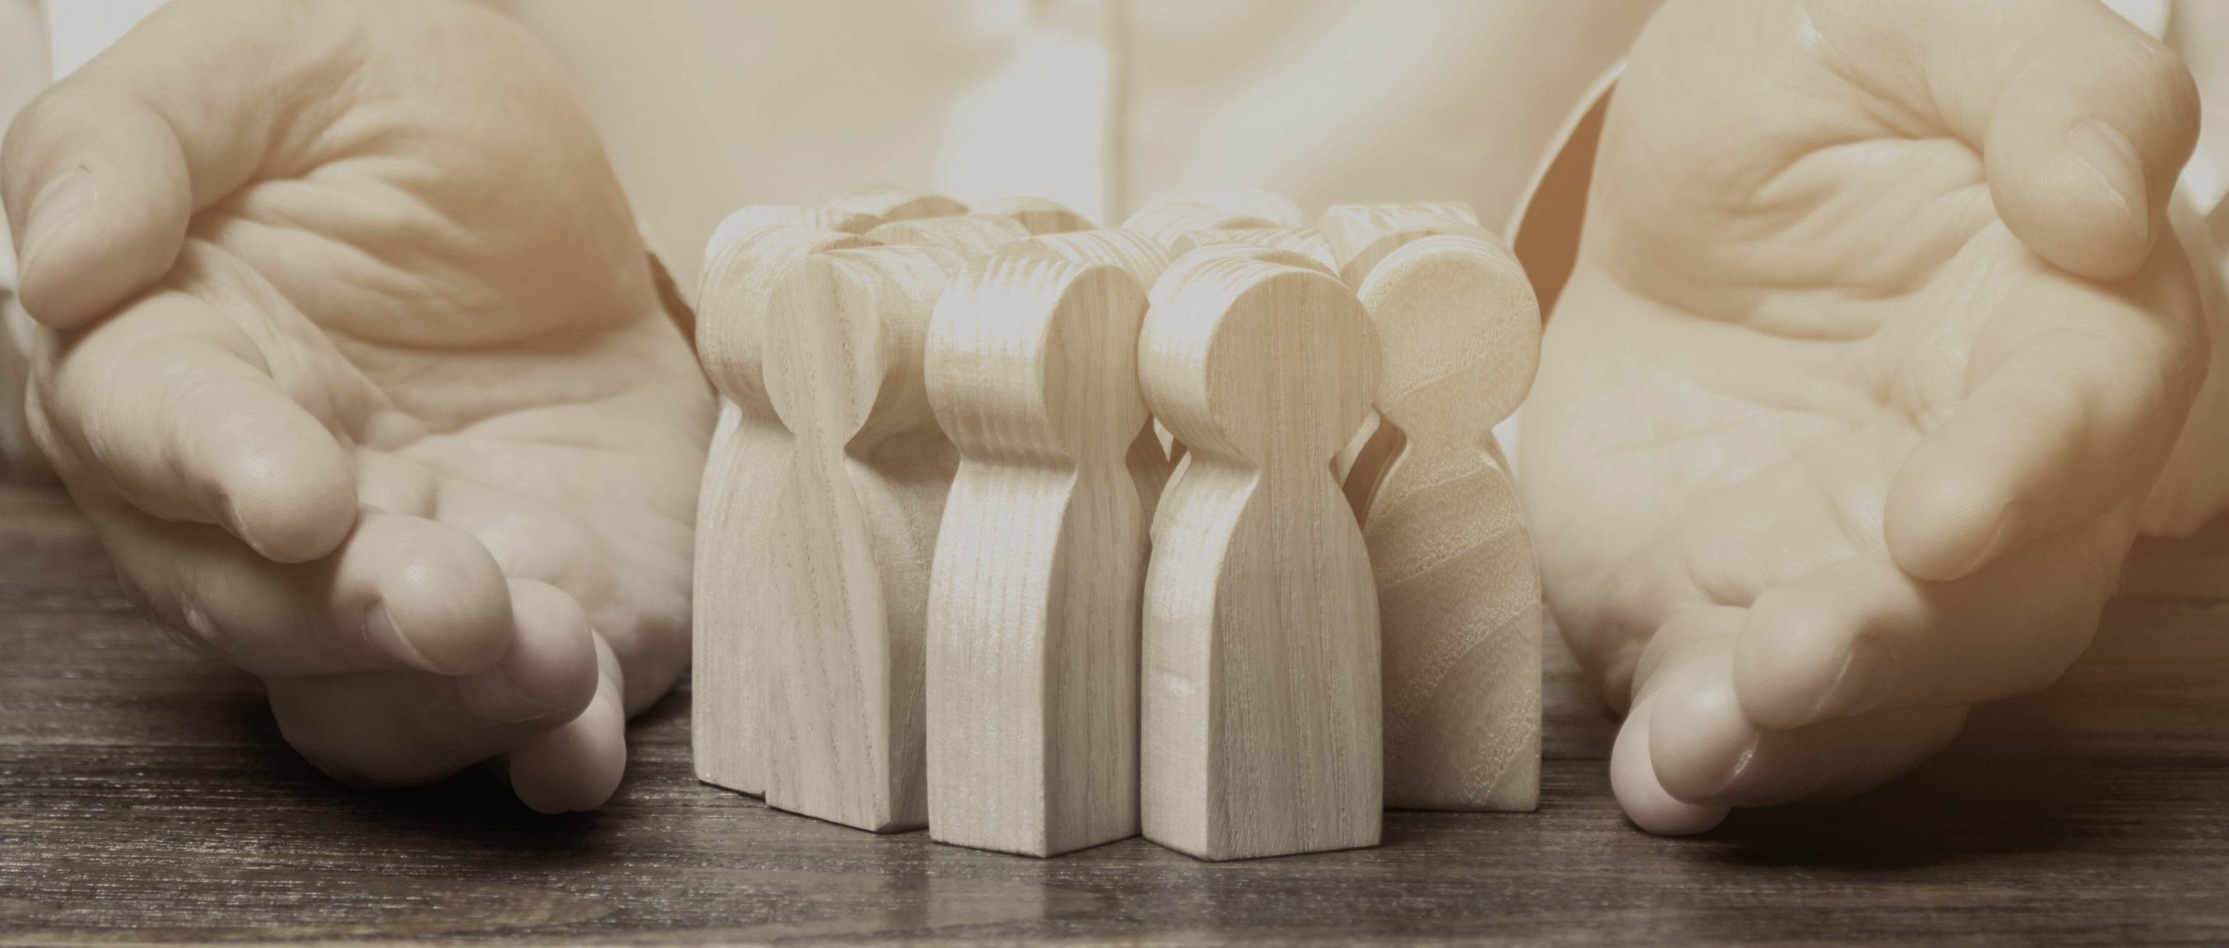
We were created as part of a relational system by the Creator's decision and, as relational creatures, we will only achieve full realization of our potential and fulfillment of our deepest longings in an environment in which we can develop and enjoy healthy relationships with God and others.

Slide 6
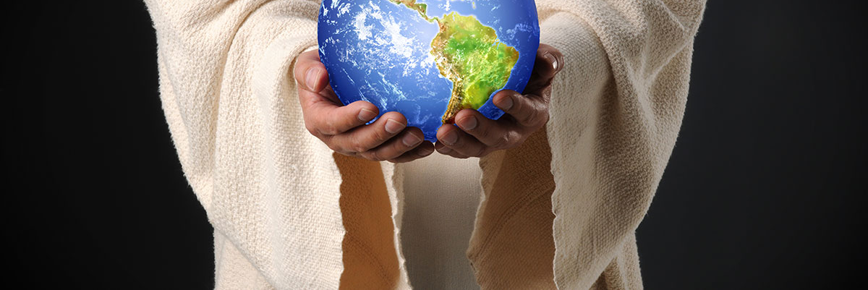
We were created as part of a relational system by the Creator's decision and, as relational creatures, we will only achieve full realization of our potential and fulfillment of our deepest longings in an environment in which we can develop and enjoy healthy relationships with God and others.

Slide 7
The image of the Deity in the human being provides the basis for developing healthy relationships, characterized by solidarity, trust and love.

Slide 8
From the Genesis 2 story, we can infer that we, as humans, have affinity with each other and can develop meaningful relationships with other human beings, not only because we were created by God, but also because God chose one couple to be the origin of all humanity.

Slide 9
Another aspect of the relational dimension of Old Testament Theology can be observed from the concept of the covenant, the relational dimension of creation is intertwined with the relational nature of the Creator.

Slide 10
With Noah, God signed a contract, an agreement, universal in its reach and unconditional in its demands.
With Abraham, the Lord established a special relationship. God made promises to bless all the families of the earth through the Abrahamic seed.

Slide 11
At Sinai, the redeeming God entered into a special relationship with Israel, affirming the covenant with the chosen nation. Through the prophet Jeremiah, God proclaimed the good news of a "new covenant". The law would be engraved on the heart, and the relationship between God and his people would be marked by forgiveness of sin and knowledge of God (Jer.31:31-34).

Slide 12
We notice, then, in the course of Old Testament history, a relational God in search of communion with relational beings created by him.

Slide 13
A Missional Theology
Groups are important characters in the Old Testament. The group is perceived as the intermediate sphere through which God reaches the individual.

Slide 14
(Leviticus 4)
3. In the sapiential literature, of the principle that a group is more effective than an individual, it is found in:
1. One pursues a thousand, but two put ten thousand on the run.
2. The unintentional sin of the anointed priest brings guilt upon all the people, whom he represents. The importance of the group in its interaction with the individual is perceived here.
(Deuteronomy. 32:30)
Ecclesiastes 4:10-12

Slide 15
4. The biblical story reveals God acting in human history through groups in order to fulfill a mission.
6. Abraham's organized group should have become a blessing for all families.
5. The family, the basic and primordial group, was established by God to fulfill purposes.

Slide 16
(Num. 4:1-33)
(1 Chron. 24:1-19)
8. When the tabernacle was replaced by a permanent structure, various groups were organized to perform various functions in the liturgy and in the temple service.
7. In the tabernacle in the desert, we observe that God used organized groups to accomplish specific tasks.

Slide 17
From the perspective of the Old Testament, we note that relational and missional dimensions characterize the human groups called by God throughout salvation history.

Slide 18
Finally, we note that these groups were organized to fulfill a mission, or task, entrusted to them by God.

