Slide 2
What is the Mission of Christ
John 15:16, 17
“Ye have not chosen me but I have chosen you, and ordained you, that ye should go and bring forth fruit, and that your fruit should remain: that whatsoever ye shall ask of the Father in my name, he might give it to”

Slide 3
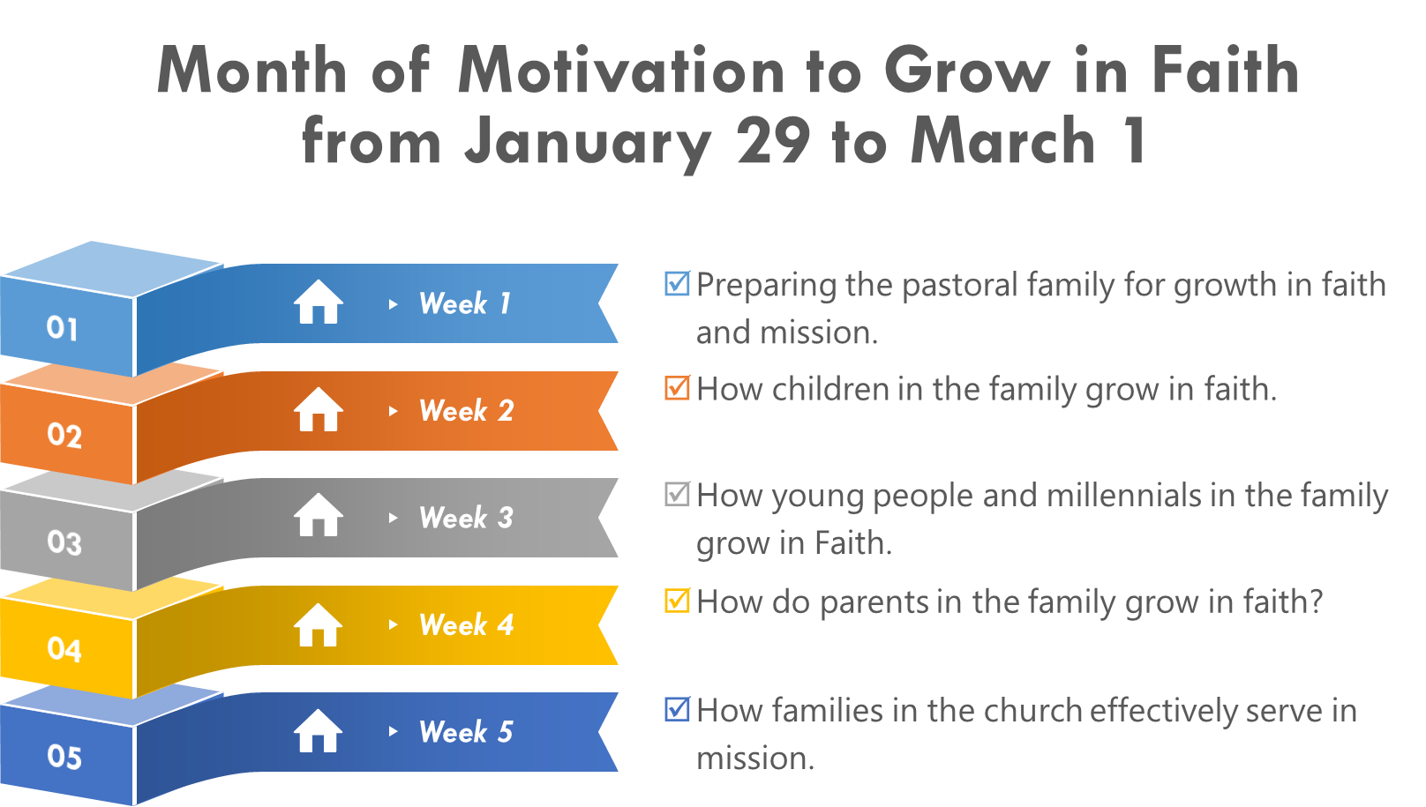

Slide 4
Bible study
Beginning of Bible studies January 14
1. Study bible lessons with your social partners
2. Receive the lessons from the Division page or however the union or local field determine
3. Ensure that your partners receive their certificates at the end of the studies

Slide 5
Social Projects in the Community
Start of social projects in the community –
January 21
Each union and local field develop a menu of social projects to be conducted in the communities
Each local church determine relevant social projects to be conducted in the community
Each family determine the projects they will execute
Families execute their projects

Slide 6
Reaping of Souls
in three quarters
Three Evangelism High points for the Year
April 13 to 20 - Reaping #1
June 22 to 29 - Reaping #2
September 21 to 28 - Reaping #3
Each local union and field determines who will lead the reaping campaigns and how.

Slide 7
Baptismal Celebrations
Three Evangelism High points for the Year
April: 20 - Reaping Celebration #1
June: 29 - Reaping Celebration #2
September 28 - Reaping Celebration #3

Slide 8
UNIONS TO PARTICIPATE IN THE CONGRESS AND BAPTISMAL CELEBRATION FROM HONDURAS
Honduras
Guatemala
El Salvador
South Central America
Panama
South Colombia
East Venezuela
West Venezuela

Slide 9
UNIONS TO PARTICIPATE IN THE CONGRESS AND BAPTISMAL CELEBRATION FROM GUADELOUPE
French Antilles Guiana
Central Mexican
North Colombia
Southeast Mexico
Haiti
Chiapas
Interoceanic Mexican
North Mexico

Slide 10
UNIONS TO PARTICIPATE IN THE CONGRESS AND BAPTISMAL CELEBRATION FROM JAMAICA
Jamaica
Caribbean
Belize
Dutch Caribbean
Atlantic Caribbean
Dominican Republic
Puerto Rico
Cuba

Slide 11
AFM Festival
Sabbath November 2
Worship Service Division wide:
Celebrate all the achievements of the program
Receive Reports
Talk about the value of Church membership
Celebrate the membership that we have achieved at all levels

Slide 12
Retention Rally –
Sabbath November 30
Worship Service in every Union to:
Celebrate all newly baptized members during the year 2024
Conduct special nurturing service to spiritually motivate all members in the faith
Provide seminar on the importance of maintaining the faith
Conduct potluck in all territories of the division where members eat together

Slide 13
Here are some strategies pastors can use to encourage involvement of the members in the program ALL THE FAMILY IN MISSION:

Slide 14
How families may unite in Christ’s mission
“Well-ordered and disciplined family tells more on behalf of Christianity than all the sermons that can be preached” (Adventist Home)

Slide 15
1. Registration
Get the members to register at aim2024.interamerica.org
The program has Four Aspects:

Slide 16
All the Family in Mission
2024
Growing in the Faith
Serving in the Community
Sharing the Gospel
Reaping God’s harvest

Slide 17
Churches can help those who cannot register:
Establish at least two e-mail addresses and passwords; One for members registration and the other for the family, friend or visitor that they will study with.
Appoint a registration coordinator in the church to do the registration on behalf of those members who cannot.

Slide 18
2. Vision Casting
Clearly articulate the vision and mission of the program to the members.
Explain how it aligns with the broader mission of the church and the teachings of Christ.
Share stories and testimonies to illustrate the impact that the program can have on individuals and the community.

Slide 19
3. Inclusive Planning
Involve singles and couples in the planning process.
This gives them a sense of ownership and ensures that the program meets their needs and utilizes their strengths.

Slide 20
4. Training and Equipping
Provide training sessions that equip participants with the necessary skills and knowledge to effectively reach out to others.
This could include training in communication skills, how to connect with people and share your faith with them.
Invite persons to do special training with all those who are registered.

Slide 21
5. Mentorship and Discipleship
Pair less experienced individuals with mentors who can guide them through the process.
Small Group arrangements are ideal.
This helps build confidence and ensures that they are not working alone.

Slide 22
6. Service Opportunities
Create a variety of opportunities for the members to provide service that cater to different interest, abilities and needs.
This could range from community service projects to hosting social events or small group Bible studies..

Slide 23
7. Personal Testimonies
Encourage members to share their personal faith stories.
This can be a powerful tool for connecting with others and showing the transformative power of Christ's message.

Slide 24
8. Enhance Team Building
Build a strong, supportive teams within the church.
When singles and couples feel connected and cared for, they are more likely to want to share that experience with others.

Slide 25
9. Recognition and Encouragement
Acknowledge the efforts and contributions of those involved in the program.
Celebrate successes and provide encouragement during challenges.

Slide 26
10. Prayer and Spiritual Support
Emphasize the importance of prayer in the outreach process.
Encourage participants to pray for each other, for those they are reaching out to, and for the success of the program in general.

Slide 27
11. Flexible Participation
Recognize that not everyone may be able to commit the same amount of time or resources.
Offer different levels of involvement so that everyone can participate in some way.

Slide 28
12. Regular Feedback and Adaptation
Solicit feedback from participants and those they reach out to
Use this feedback to make adjustments to the program as needed.

Slide 29
13. Integration with Church Life
Ensure that the program is not seen as separate from the rest of church life.
Integrate it with worship services and other church activities. It is one program we have not two.

Slide 30
14. Use of Technology
Utilize social media, websites, and other digital tools to connect with people, share resources, and coordinate outreach efforts.

Slide 31
15. Cultural Relevance
Make sure that the program is culturally relevant and sensitive to the backgrounds of the people being reached.

Slide 32
16. Sustainability
Plan for the long-term sustainability of the program.
This includes developing leaders who can carry on the program and ensuring that resources are available.

Slide 33
Reminder
It's important to remember that each church and community is unique, so pastors should tailor their approach to fit their specific context.

Slide 34
Maintaining the FAMILY Happy in the Mission
BALVIN BRAHAM

Slide 35
Happy Church Members
Having happier church members can yield numerous benefits for both the individuals and the church community as a whole. Here are some of the key advantages of having happier church members:

Slide 36
1. Increased Engagement and Participation
Happier members are more likely to be actively involved in church activities, from attending services regularly to volunteering for various ministries and events

Slide 37
2. Stronger Team Bonding
A happy congregation fosters a sense of belonging and community, which can lead to deeper relationships and a more supportive network among members.

Slide 38
3. Higher Retention Rates
When church members are content and fulfilled, they are less likely to seek other places of worship, leading to increased retention and stability within the church.

Slide 39
4. Positive Word-of-Mouth
Satisfied members are more likely to invite friends, family, and acquaintances to church events, which can help the church grow and reach new people.

Slide 40
5. Enhanced Volunteerism and Stewardship
Happy members are often more generous with their time and resources, contributing to the church's missions and financial health through tithes, offerings and use of their talents and influence.

Slide 41
6. Improved Well-being of Members
A positive church experience can contribute to the overall well-being of members, including their mental, emotional, and spiritual health.

Slide 42
7. Greater Impact on the Community
A vibrant and happy congregation is more effective in its outreach efforts, making a positive impact on the local community through service and evangelism.

Slide 43
8. Resilience in Times of Challenge
When members are content and connected, the church community is better equipped to handle crises and challenges, whether they are personal or affecting the entire congregation.

Slide 44
9. Leadership Development
A nurturing and happy church environment is conducive to identifying and developing new leaders who are committed to the church's vision and mission.

Slide 45
10. Cultural Relevance
Churches that keep their members happy are often more adaptable and responsive to cultural changes, allowing them to remain relevant and effective in their ministry.

Slide 46
In General
happier church members contribute to a dynamic and thriving church that can better fulfill its mission and serve its community.

Slide 47
Five strategies that pastors can employ to keep members happy

Slide 48
Five strategies that pastors can employ to keep members happy:

Slide 49
1. 1. Create Fellowship Opportunities
Encourage social events and small group meetings that allow members to form relationships and support networks within the church.
Create opportunities for members to serve together in outreach programs or community service projects, fostering a sense of purpose and teamwork.
Implement programs for different age groups and interests to ensure that everyone has a place where they feel they belong.

Slide 50
1. 2. Provide Inspiring and Relevant Sermons
Prepare sermons that are not only theologically sound but also applicable to everyday life, helping members to connect their faith with their personal and professional lives.
Stay informed about the issues and challenges that the congregation faces and address these topics with compassion and wisdom.
Encourage feedback and questions about sermons to ensure that the messages resonate with the congregation.

Slide 51
3. Offer Pastoral Care and Support
Be available for counseling and personal support during times of need, such as illness, loss, or personal struggles.
Train and empower a pastoral care team to assist in providing emotional and spiritual support to church members.
Develop a system for checking in on members who are absent or going through difficult times, showing that the church community cares for each individual.

Slide 52
4. Encourage Spiritual Growth and Discipleship
Provide educational opportunities such as Bible studies, workshops, and retreats that help members deepen their faith and understanding of religious teachings.
Mentor and develop leaders within the congregation who can help guide others in their spiritual journeys.
Recognize and utilize the diverse spiritual gifts of the congregation, allowing members to contribute in ways that are meaningful to them.

Slide 53
5. Promote Transparency and Inclusivity
Communicate openly about church decisions, finances, and future plans, building trust through transparency.
Encourage participation from all members in the decision-making processes, valuing their input and ideas.
Create an inclusive environment where all members, regardless of background, feel welcomed and valued.

Slide 54
CHRIST'S OBJECT LESSONS, P. 69.
"Christ is waiting with longing desire for the manifestation of Himself in His church. When the character of Christ shall be perfectly reproduced in His people, then He will come to claim them as His own"
(Ellen G. White).

