Slide 1

Consultative Session with Family Life Leaders
Manchester
Pastor Joel Shillingford
Ministerial Secretary & Director, Family Ministries
Central Jamaica Conference of Seventh-day Aventists

Slide 2

God's Original Plan for the Family
Biblical Foundation
Genesis 1:26–28
Genesis 2:18–24
Matthew 19:4–6
God established the family before government, schools, or the church.

Slide 3

God's Original Plan for the Family
The family is:
God's first institution
The foundation of society
The primary place of spiritual nurture
Quote
"The family tie is the closest, the most tender and sacred of any on earth."
Ellen G. White, The Ministry of Healing, p.356.

Slide 4

Why Family Ministries?
Modern families face:
Divorce
Domestic violence
Child abuse
Substance abuse
Mental health challenges
Financial stress
Digital addiction
Parenting difficulties
Healthy families produce healthy churches.
Strong families make strong disciples.

Slide 5

Early SDA Emphasis on Families
Although no Family Ministries Department existed in the early church, the pioneers emphasised:
Christian homes
Marriage
Parenting
Child training
Family worship
Ellen White wrote extensively on:
The Adventist Home
Child Guidance
Messages to Young People
These became the theological foundation for Family Ministries.

Slide 6

Development of Family Ministries
During the 1960s–1970s:
Rising divorce rates
Social changes
Women's changing roles
Family instability
Church leaders recognised the need for organised ministry devoted specifically to families.
Family ministry moved from occasional programming to intentional discipleship.

Slide 7
Establishment of the Family Ministries Department
The organised Family Ministries Department of the Seventh-day Adventist Church began in October 1919 with the creation of the Home Commission, which later transitioned into official department structures formalised in the 1970s. Key foundational milestones include:

Slide 8
Establishment of the Family Ministries Department
Adventist Family Ministries
1919 Establishment: The General
Conference Committee launched the
Home Commission on October 8, 1919.
2. 1922 Operation: Arthur W. Spalding
and his wife Maud began active
leadership and literature creation in
1922.
1974 Formal Department: The modern Adventist Family Ministries Department was officially organised in 1974.

Slide 9
Programmes now include:
Marriage enrichment
Parenting seminars
Singles ministry
Family retreats
Premarital preparation
Grief recovery
Family worship initiatives

Slide 10
Family Ministries in the SDA Church Working Policy
According to the Seventh-day Adventist Church Working Policy (K 10 Objectives Family Ministries)
Family Ministries exists to:
Strengthen marriages
Nurture families
Promote biblical relationships
Equip parents
Support individuals at every stage of family life
It serves all families—not only traditional families.

Slide 11
Objective # 1
Strengthen Marriage
build strong marriages
improve communication
deepen commitment
encourage biblical love
Marriage is viewed as a lifelong covenant established by God.

Slide 12
Objective # 2:
Promote Healthy Family Relationships
Helping families develop:
Love
Respect
Forgiveness
Communication
Spiritual intimacy
Healthy homes produce emotionally healthy disciples

Slide 13
Objective # 3:
Equip Parents
Parents are trained to:
disciple children
nurture faith
teach biblical values
develop healthy discipline
lead family worship
"The home is the child's first school."

Slide 14
Objective # 4: Minister to Families in Every Stage of Life
The department ministers to:
Newly married couples
Families with children
Single parents
Blended families
Empty nesters
Widows and widowers
Grandparents
Singles

Slide 15
Objective # 5:
Provide Hope and Healing
Family Ministries offers support through:
counselling referrals
recovery ministries
conflict resolution
divorce recovery
grief support
crisis intervention

Slide 16


Slide 17
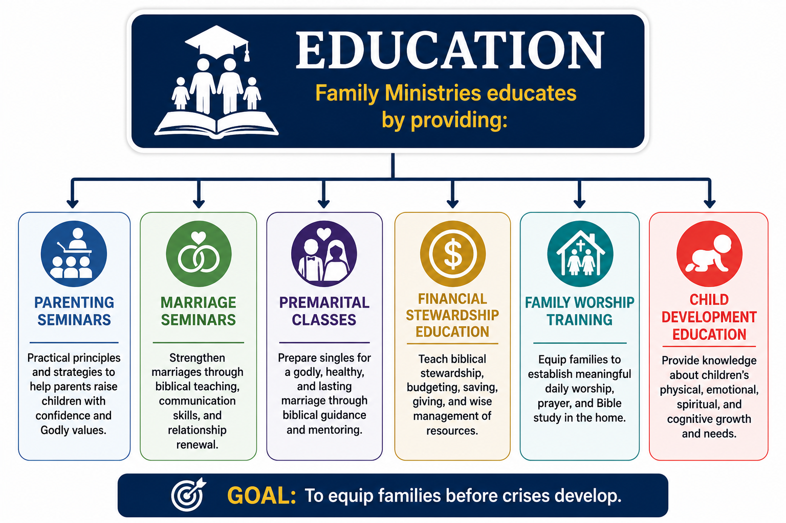
Emphasis # 1: Education

Slide 18
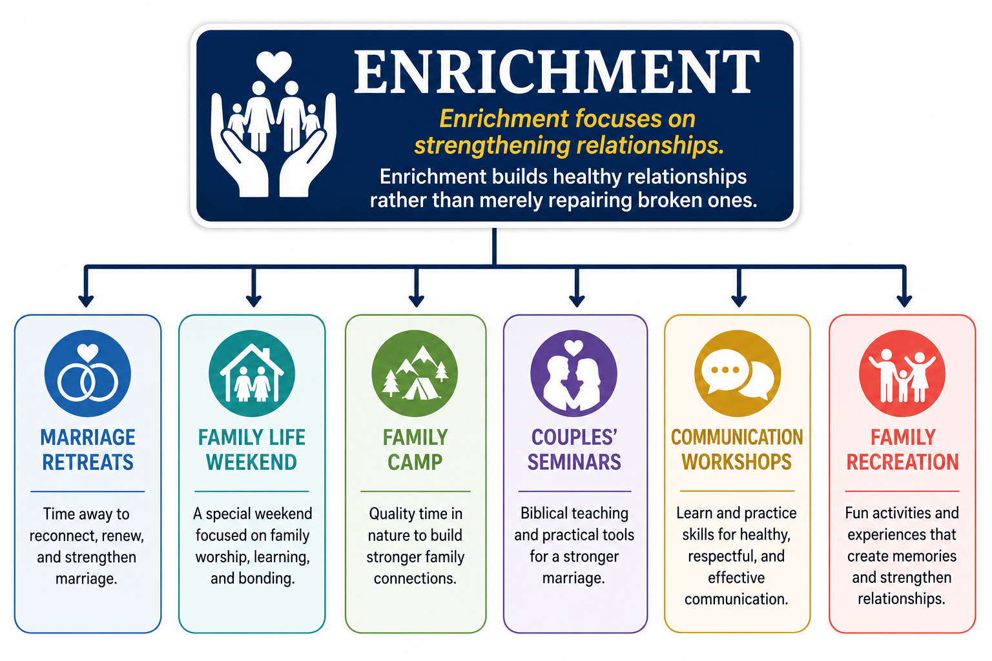
Emphasis # 2: Enrichment

Slide 19

Emphasis # 3: Counselling
Family Ministries encourages:
Biblical counselling
Marriage support
Crisis intervention
Professional Counselling
Referral to professional Christian counsellors when appropriate
The church is a safe place where people find hope.

Slide 20
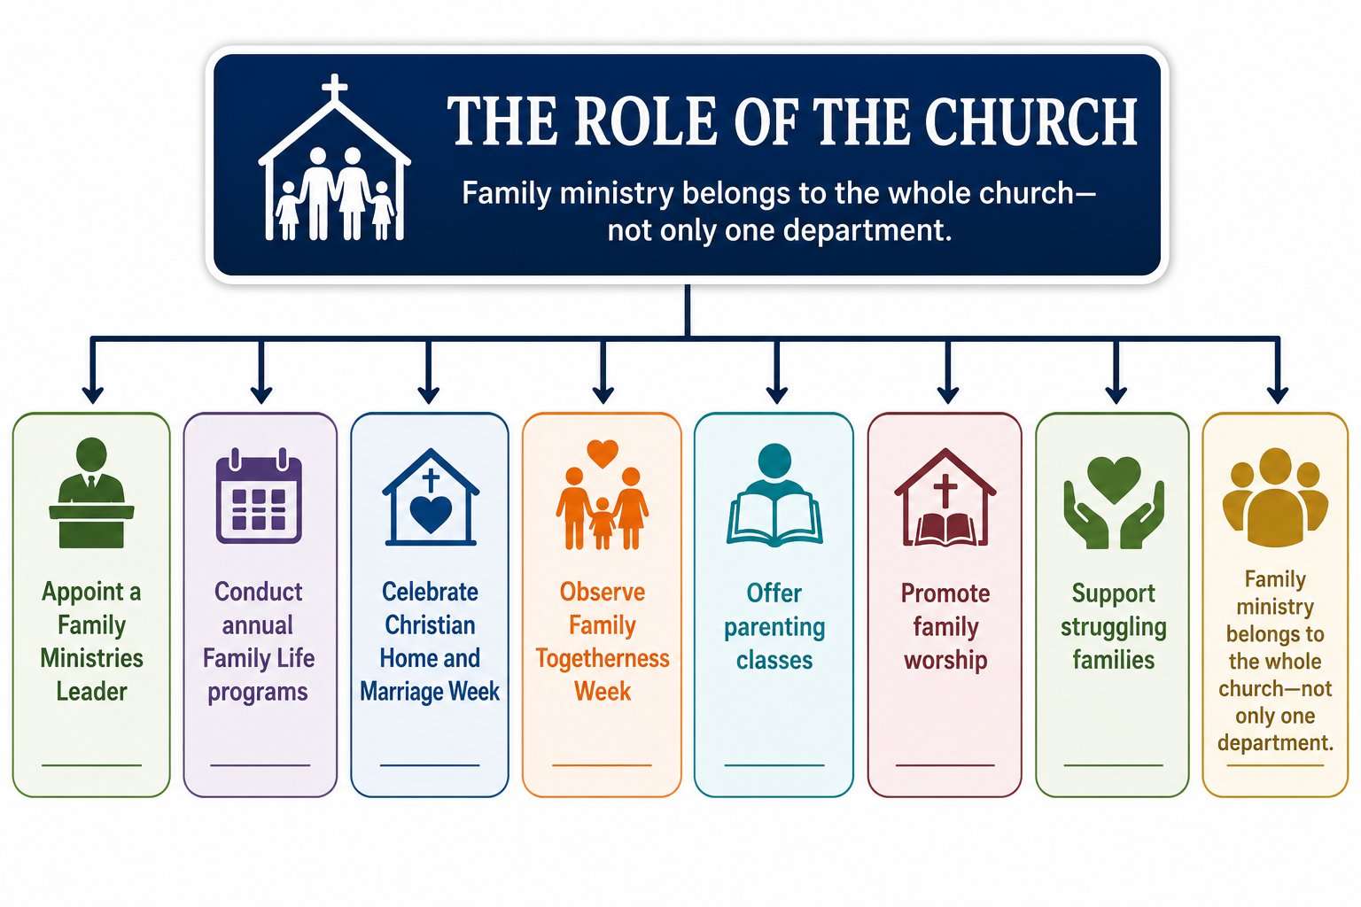

Slide 21
Challenges and Future Directions
Future priorities include:
Mental health awareness
Digital parenting
Pornography recovery
Marriage mentoring
Youth relationships
Single adult ministries
Intergenerational ministry
Family discipleship
The mission remains:
"To restore families into the image of God."

Slide 22
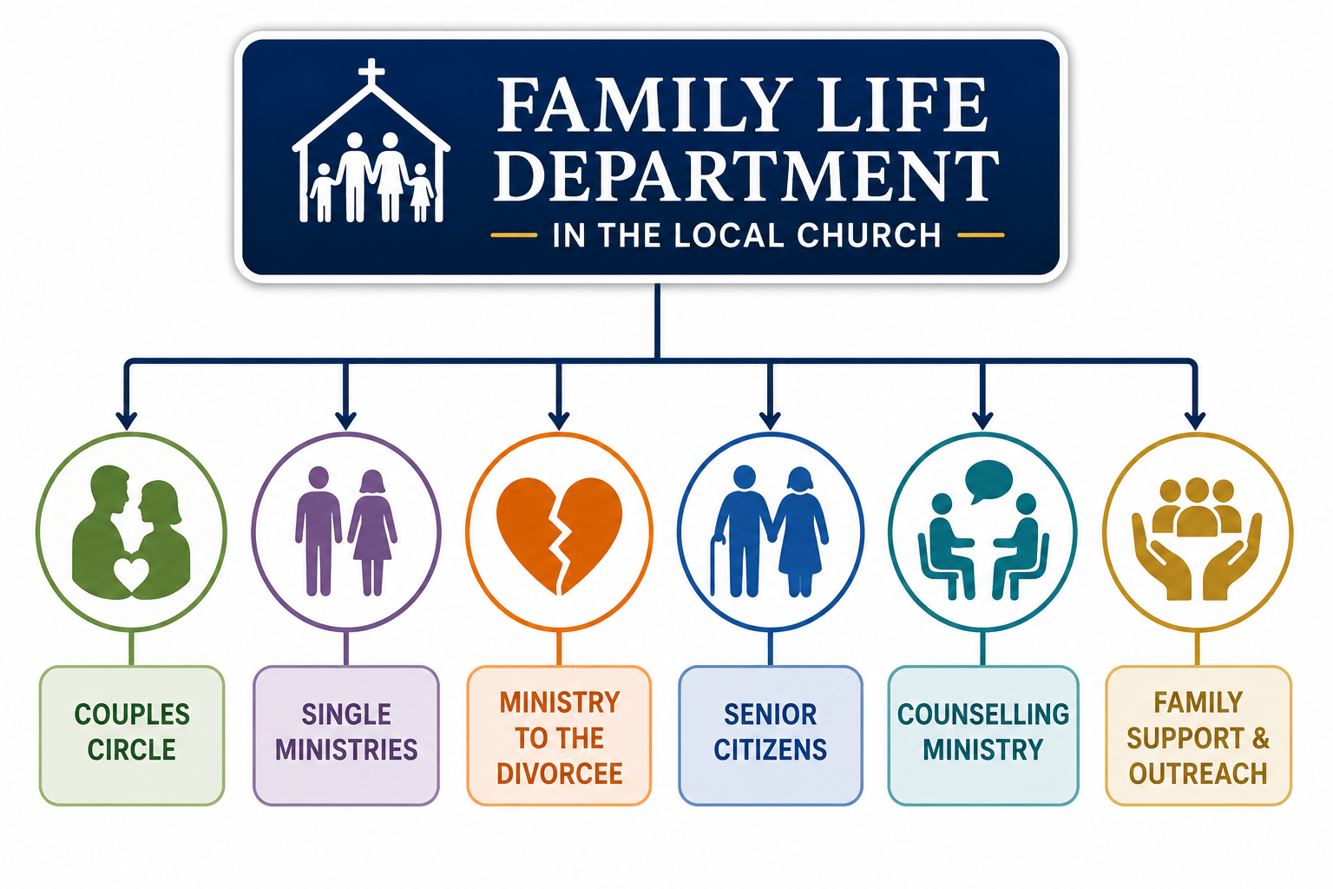
Family Life Department in the Local Church

